Slide 1
Wednesday, January 25, 2017
Write In Your Agenda:
Write In Your Monitoring Log:
CW:
Voluminous Vocabulary
Ecology Study Guide
HW:
Study for Ecology Quiz on Monday, January 30.
Response to Warm-Up:
Name one of the meerkats from Meerkat Manor and describe its niche.
You will need:
Pencil.

Slide 2
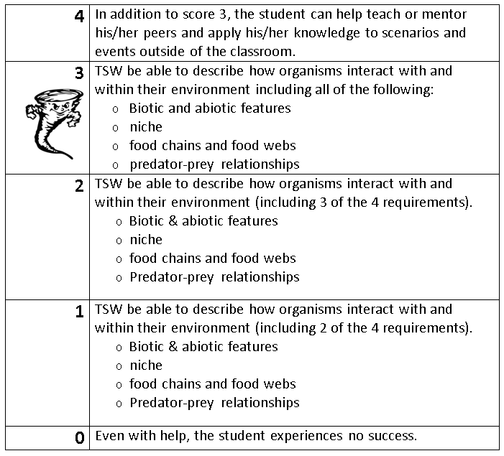
Learning Goal and Scale
TSW be able to describe how organisms interact with and within their environment (including biotic and abiotic features, niche, food chains & webs, and predator-prey relationships).

